Slide 1
UPDATES FOR SAM

Slide 2
STEPS
Plot the data Sam gave me
Generate synthetic data using each method.
Write code that predicts the reactive power control used.
Validate the performance of the code.

Slide 3
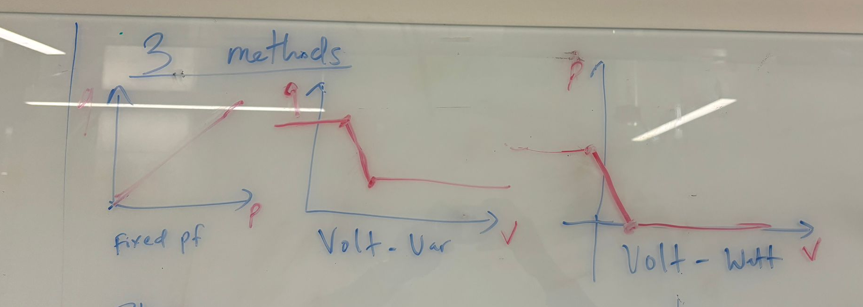
METHODS OF REACTIVE POWER CONTROL
Fixed PF
Volt-VAR control
Volt-Watt control

Slide 4
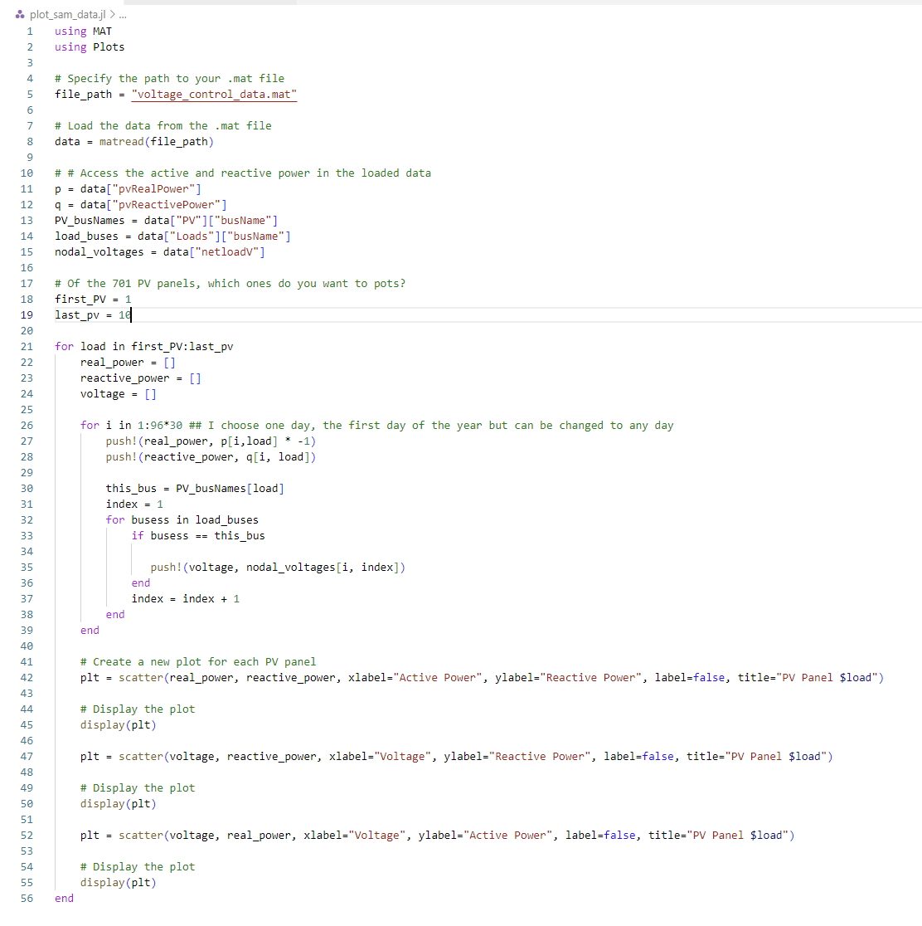
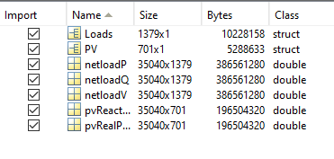
PLOTTING SAM’S DATA
QUE: How often does the setting change? Good range to plot

Slide 5
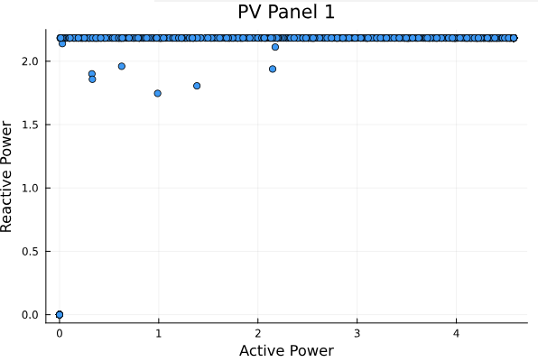
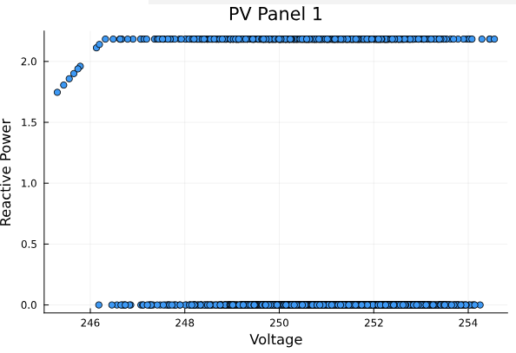
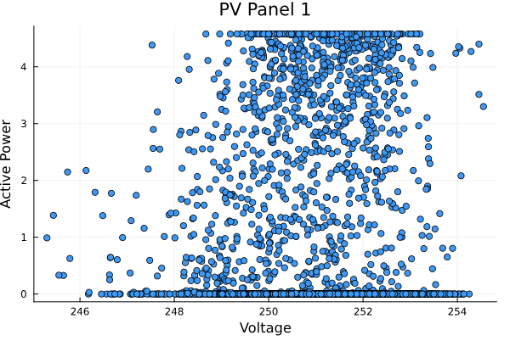
PV Panel - 1

Slide 6
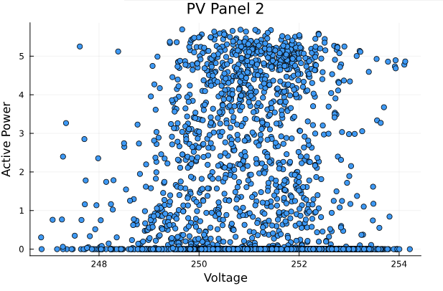
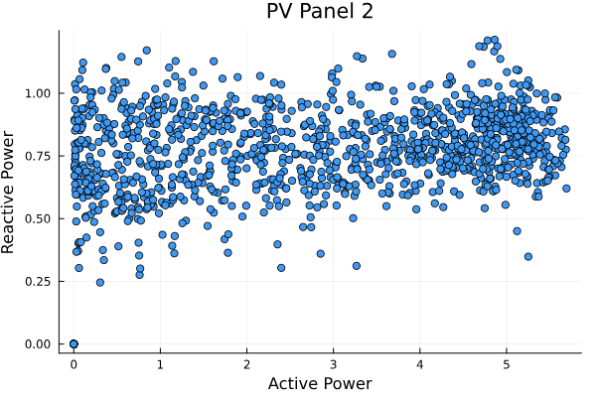
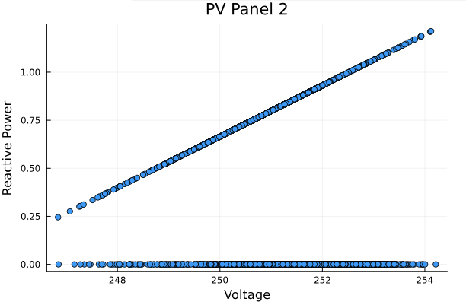
PV Panel - 2

Slide 7
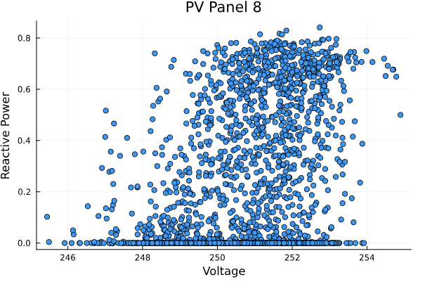
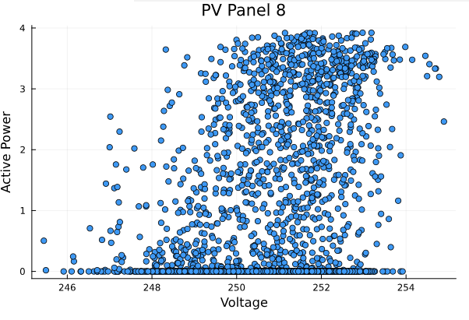
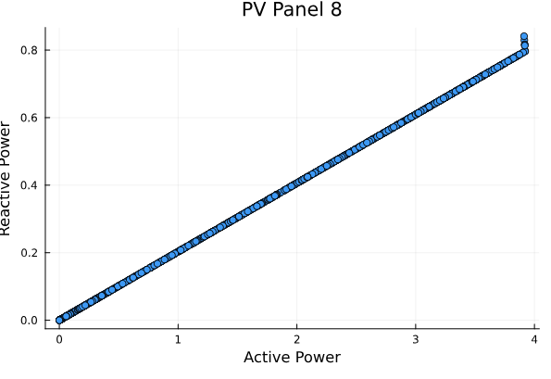
PV Panel - 8
Fair to say the control method can be determined graphically?
What about analytically?

Slide 8
ANALYTICAL METHOD
For each PV Panel, compute the following:
Power factor
Ratio of q to v
Ratio of p to v
If the 90% of power factor are within ε of each other, Fixed PF.
If the 90% of q/v are within ε of each other, Volt-Var.
If the 90% of p/v are within ε of each other Volt-Watt.

Slide 9
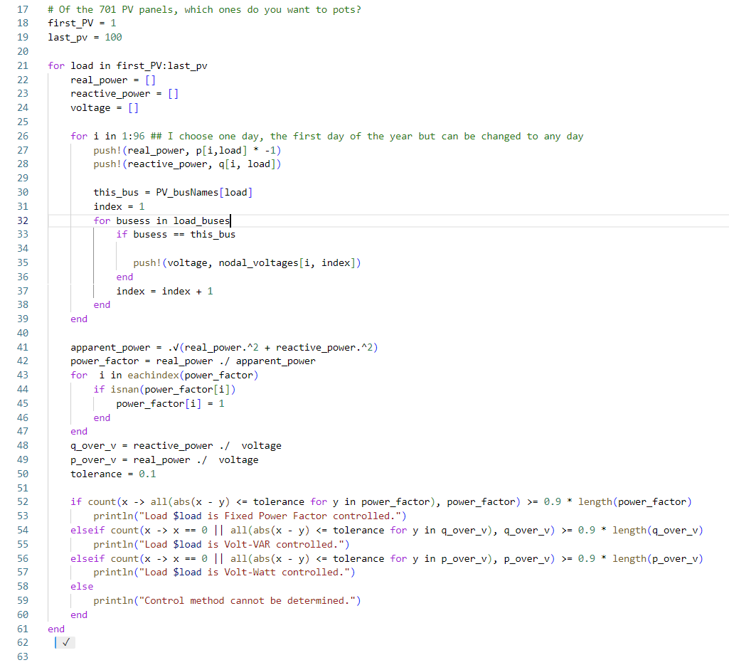
CODE

Slide 10
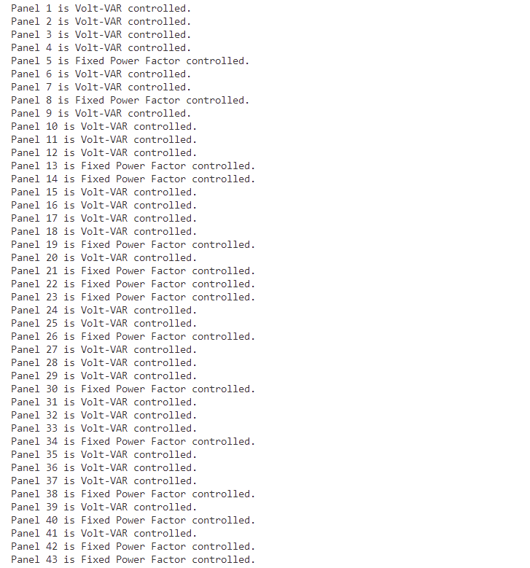
RESULTS

